Slide 1


KMS Wealth Creations
Wealth Secretes 101
By Keshav Moorthy Chandrashekar
Chief Executive Officer, KMS Wealth Creations

Slide 2


Contents
Introduction
About Me
Investing and Trading
Portfolio Buildup
Area of Focus
Summary

Slide 3
Introduction
Identifying the trades that are profitable and be able to trade the assets with absolute clarity

Slide 4
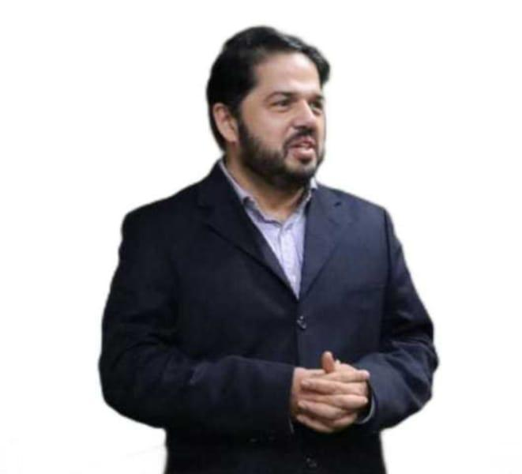
About Me
Did Engineering in Electronics and communication from Mangalore University and MS in Software from Manipal University
Worked in IT for 18 Years in United Kingdom in the financial Markets
Setup own business in Bio-Fuels in 2019 , and got recognised by various platforms
Certified trader from ‘ Traders University UK’( Now Learn to trade) since last 12 years
Helped more than 100 people to become financially independent .
Trained 500+ people about stock market and cryptos

Slide 5
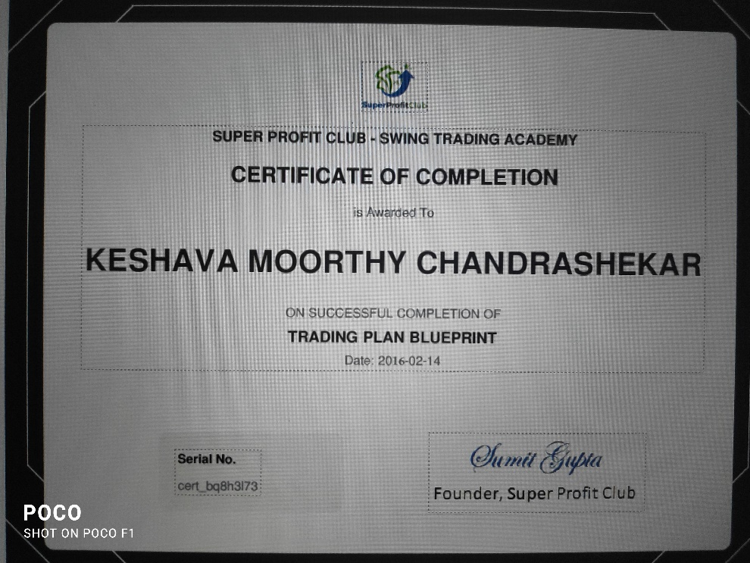
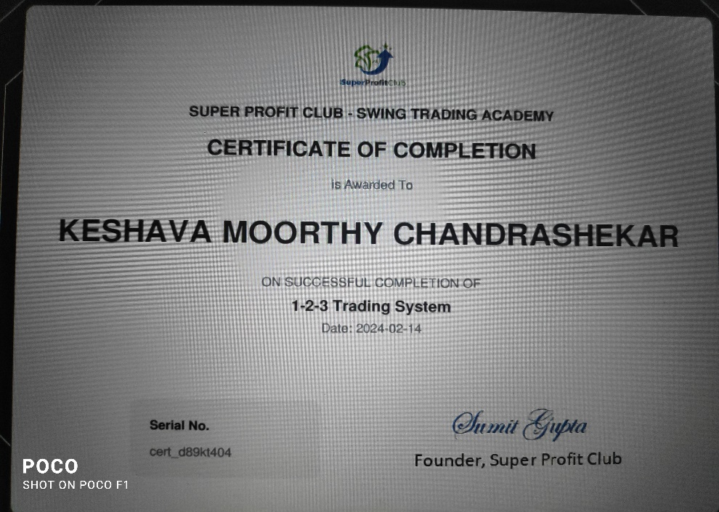
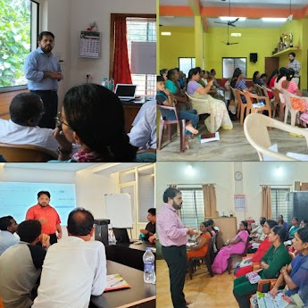

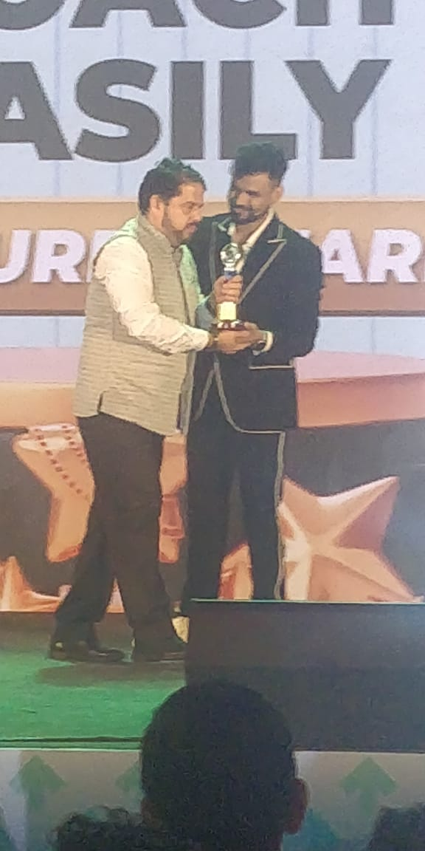


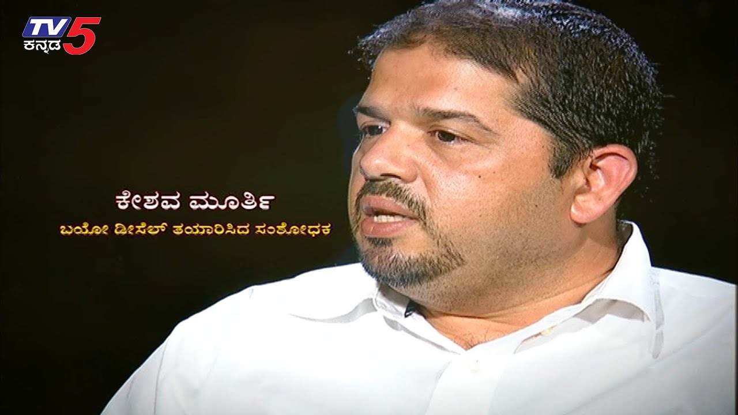


About me
Featured in

Slide 6
My Story
I was broke.
Alternative source of income
Job security
Rat race
Change
Learning and coaching
consistency and persistent

Slide 7

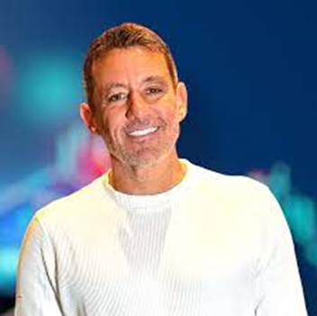
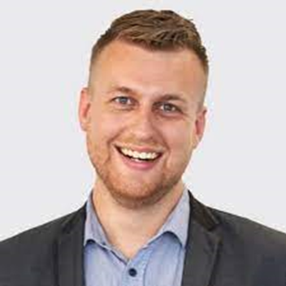
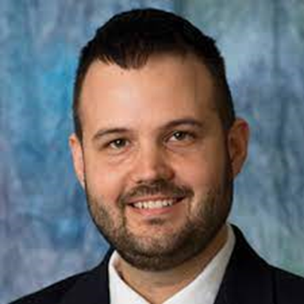
My Mentors
GREG SAKER
BAS KOOJIMAN
CASY STUBBS

Slide 8
Mission
My Mission and Vision
• To help at least 30,000 people to achieve wealth and financial freedom
• To plant and grow(support) 1,00,000 trees through my community
Vision
• To teach people to build wealth and develop the skills in them which can bring happiness and fulfil their life dreams and also working towards greener environment

Slide 9
Building Wealth
Money comes and goes, but if you have the education about how money works, you gain power over it and can begin building wealth.

Slide 10







Source 1
Real Estate
Sources of Wealth
Source 2
Gold
Source 3
Bonds, Mutual Funds
Source 4
Business

Slide 11
Difference between
Poor and Rich
1 | Time Pass
2 | Complain about the Situation
3 | Impatience
 | Value Time
 | Use the Situation as Opportunity
 | Patience

Slide 12


What is Important

Slide 13
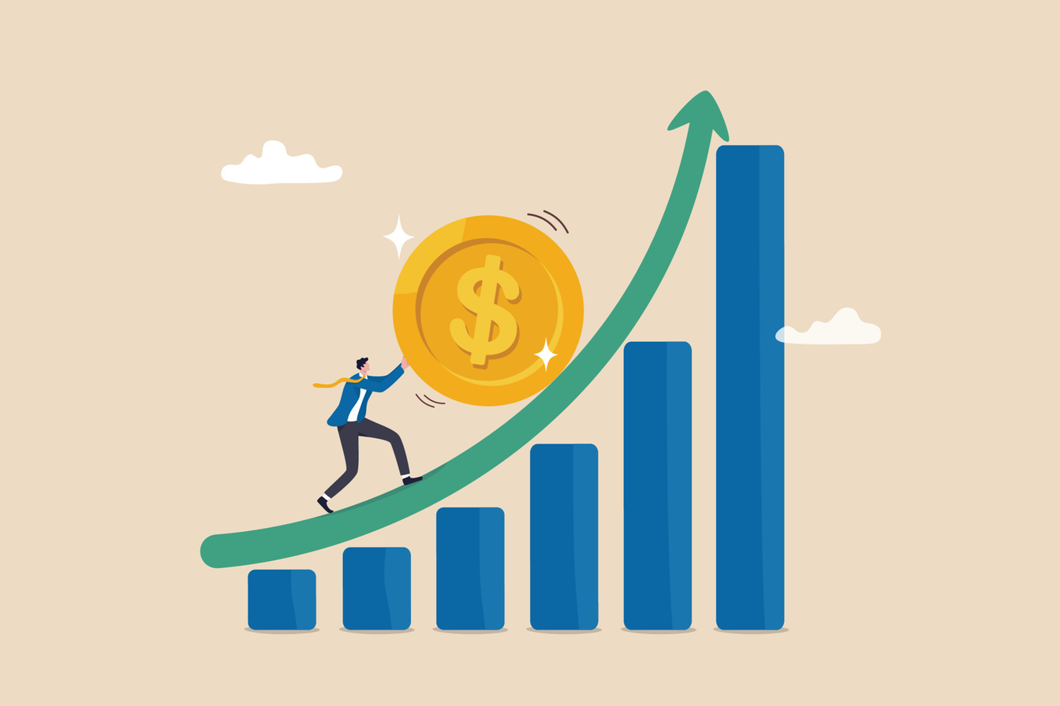
Freedom By Compounding

Slide 14
Freedom Triangle
What
Why
How

Slide 15

Trader Pyramid
Pro
Trader
Survivorr
Dabbler
Dreamer

Slide 16
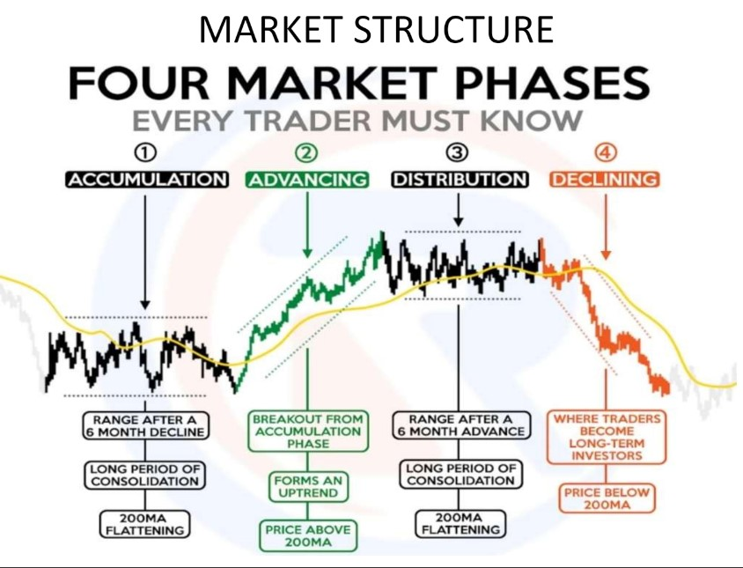

Slide 17
Primary and Secondary Market
Equities
Derivatives - Futures and Options, Spread
Types of
Markets
Forex
CFD
Crypto
Metal

Slide 18
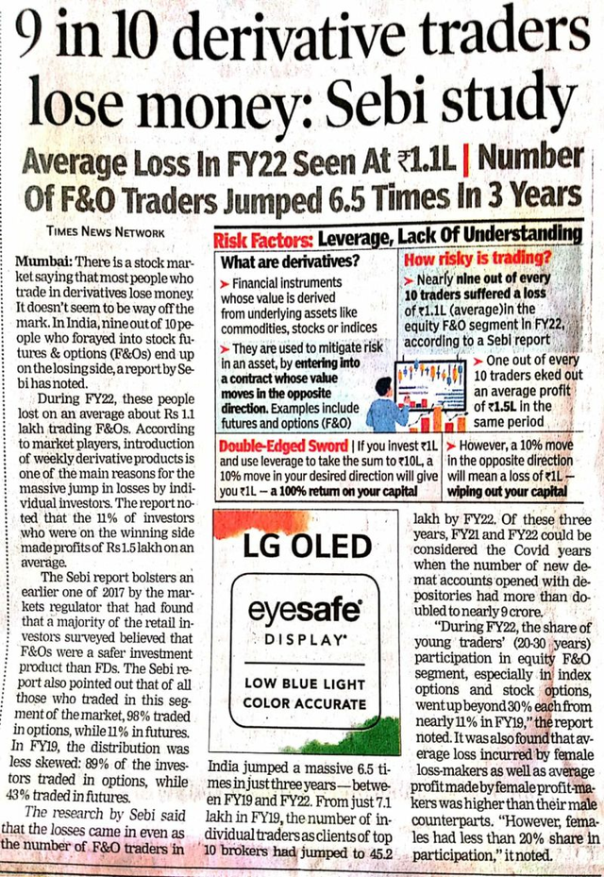
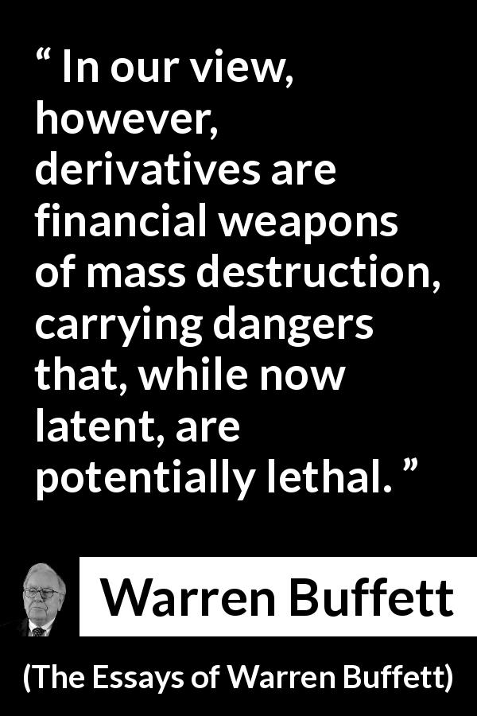
Derivatives Market

Slide 19
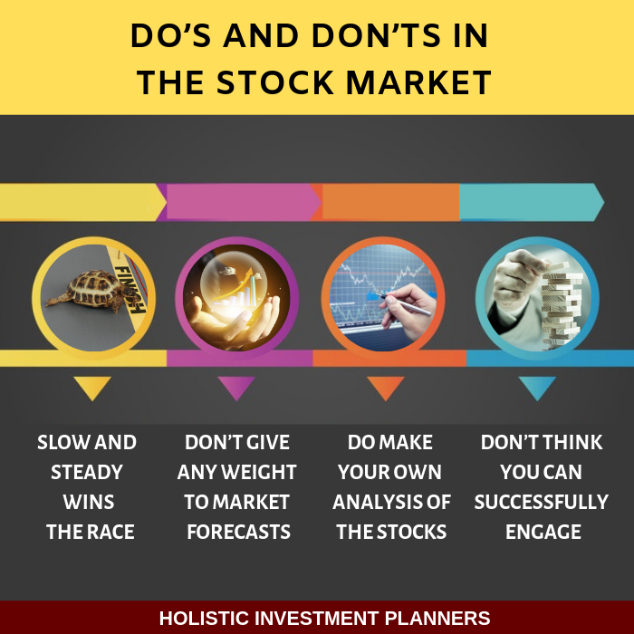

Slide 20
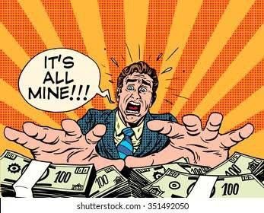
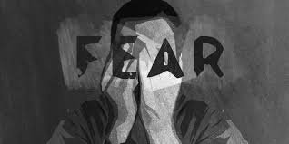
How Stock Market Works

Slide 21


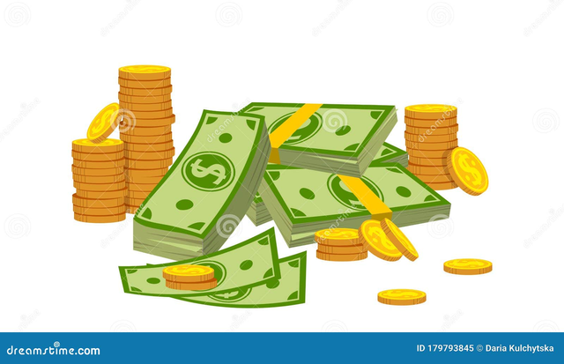
3 Top Secrets of Stock Market
Mind
Process
Money

Slide 22
Fundamental Analysis
Finantial Analysis
Global Market
Sector/Industry Analysis
Government Policies
Geo Politics
Management
Share Holding Pattern
Expansion Plans
Banking Policies

Slide 23
Technical Analysis
Price Action
Volume
Triggers and Indicators
Patters
Our Market

Slide 24
Smart Money
HIGH SKILLS-Cutting edge like a footballer
IDENTIFICATION OF MOVES EARLY
POSITIONING YOUR TRADES
EXITING AND BOOKING PROFITS at right time
Compound profits

Slide 25
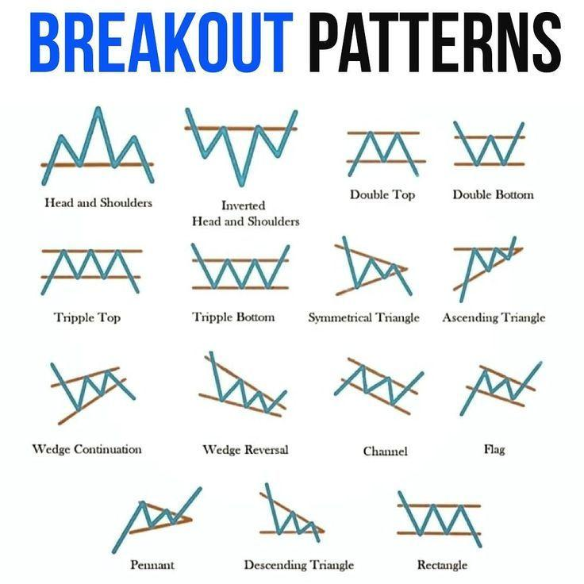

Slide 26
Important Points
Patience
Risk Management
Do Technical analysis
Be prepared for dry days
Don’t over trade

Slide 27
Technical Analysis Tips
Highly volatile stocks in Nifty 100
Volume above 5,00,000 per day –average
No event is planned for next 5 days
Use of right indicators
Making a trading plan
Don’t do trading towards long weekends

Slide 28
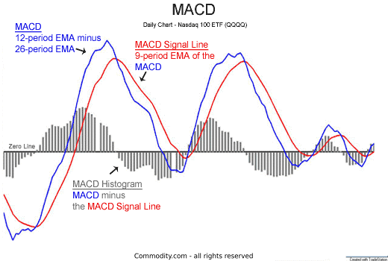
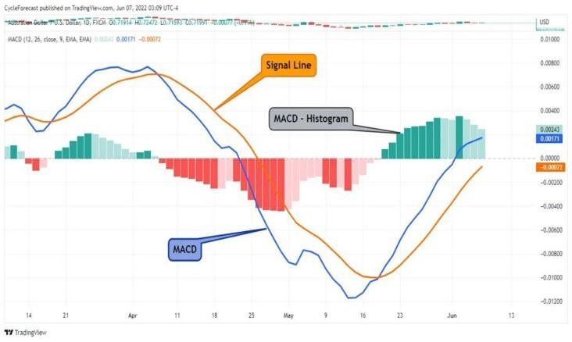
One Indicator Changed My Life

Slide 29
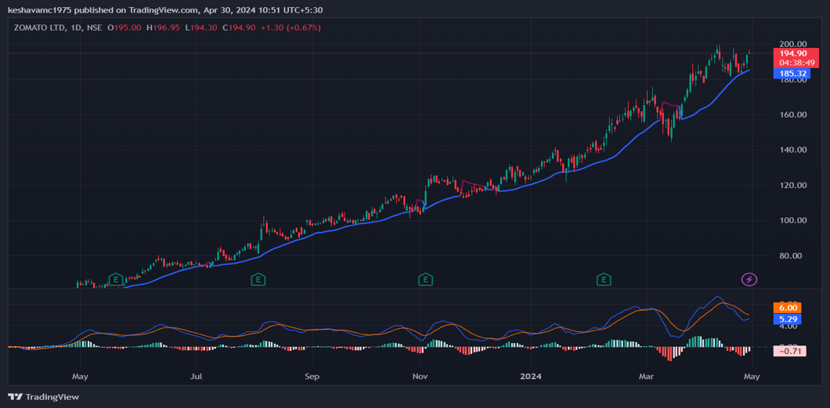
Zomato 220% Gains

Slide 30
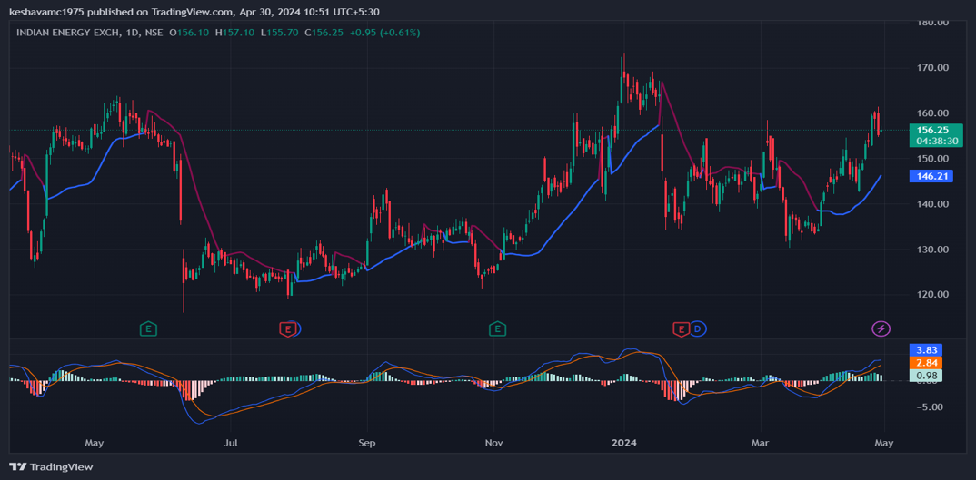
IEX 141% Gains

Slide 31
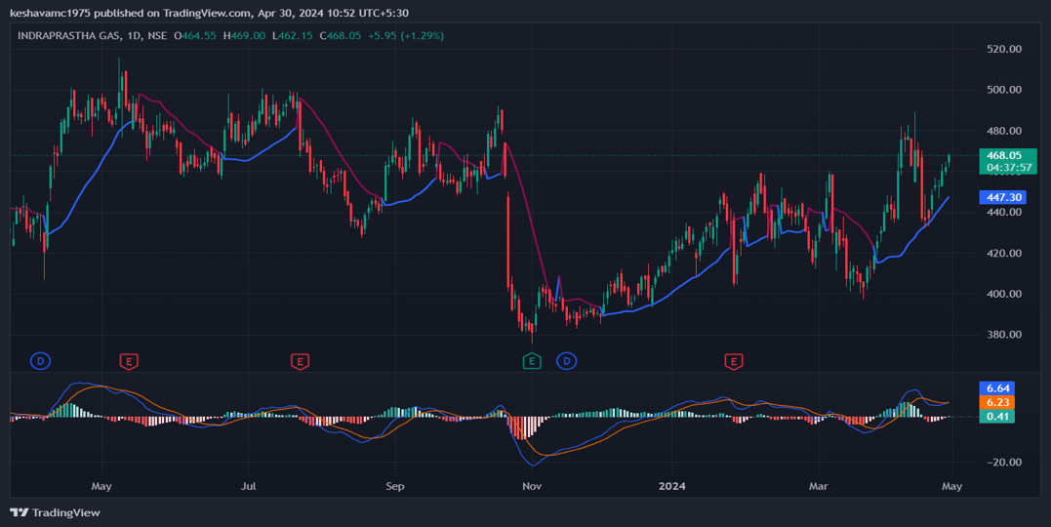
IGL 126% Gains

Slide 32
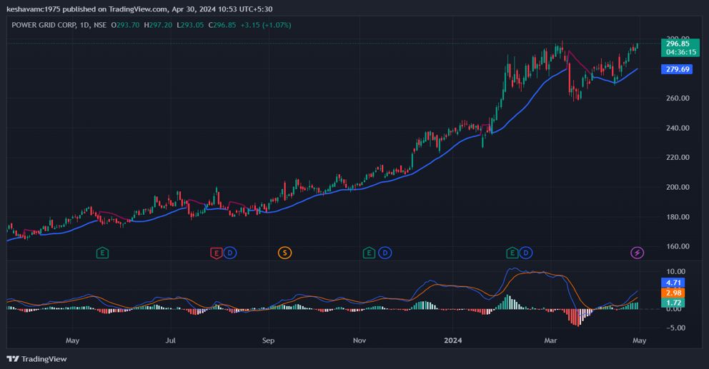
Powergrid 180% Gains

Slide 33
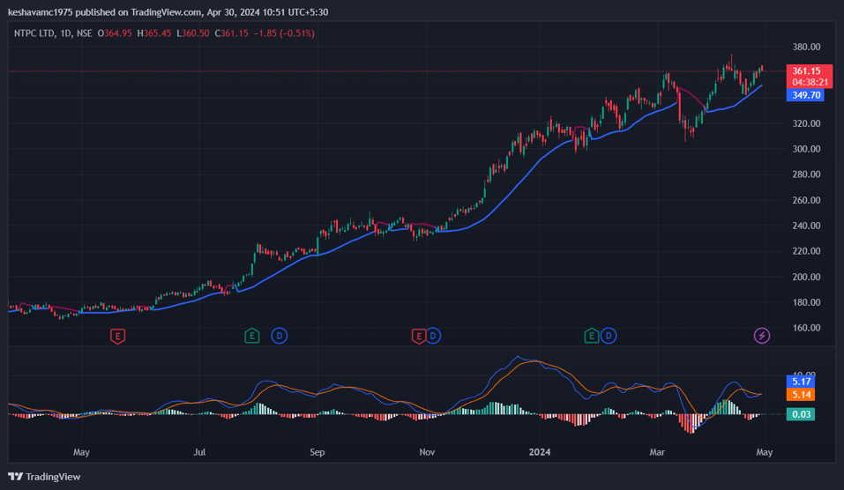
NPTC 200 % Gains

Slide 34
Buying time Systematic plan
In week one buy your 1 hour ( equivalent of one day salary)
Next week plan for 3 hours
In first month buy 3 days worth of time
In 3 months buy 10-20 days time.
And so on… But plan and execute systematically

Slide 35
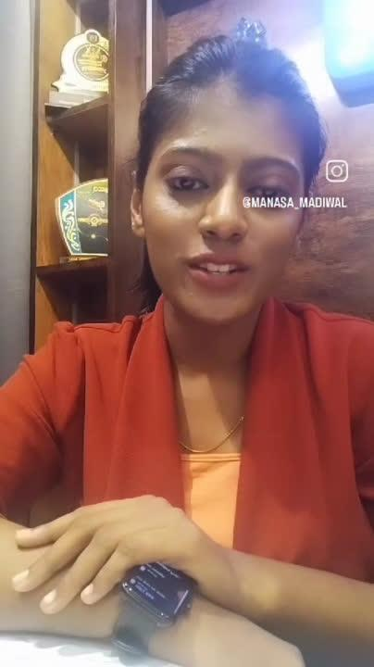
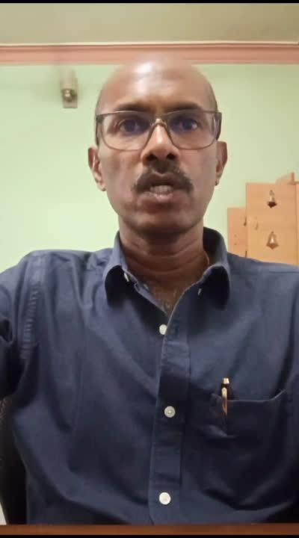
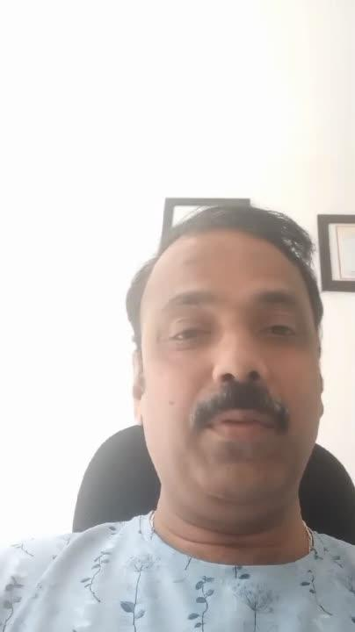
Testimonials

Slide 36
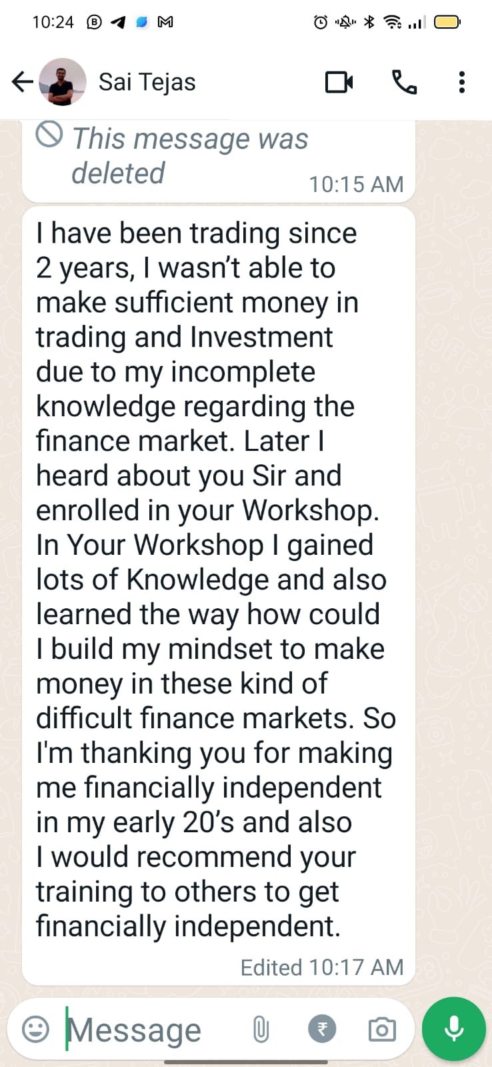
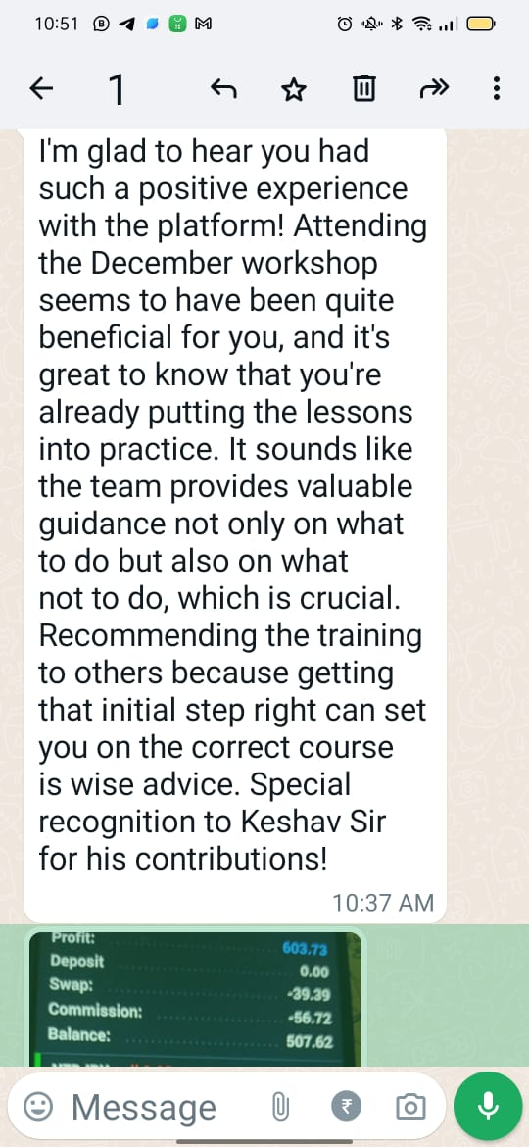
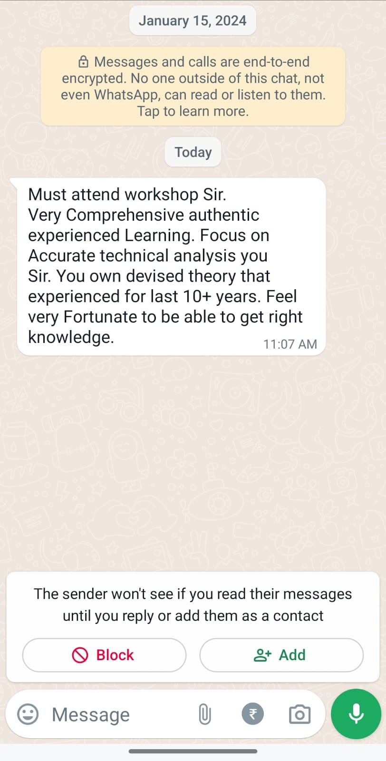

Slide 37
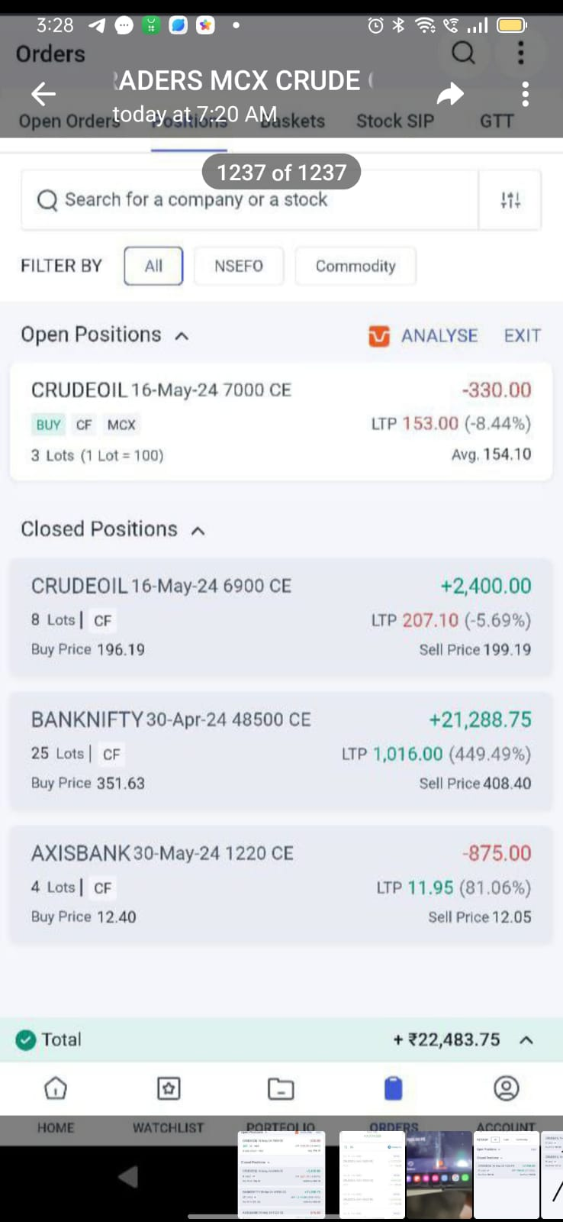
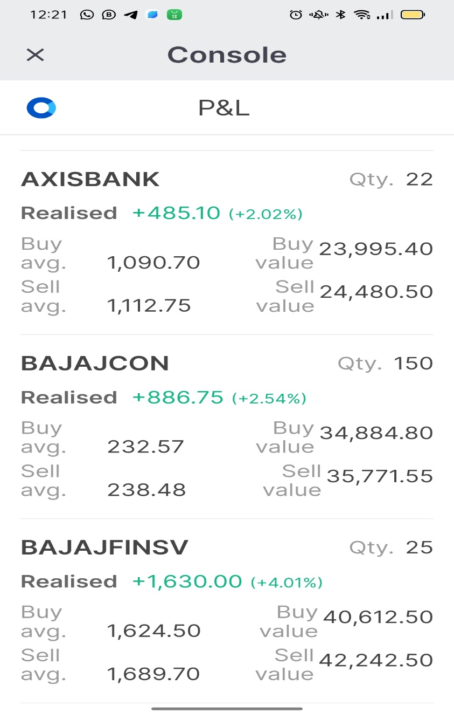
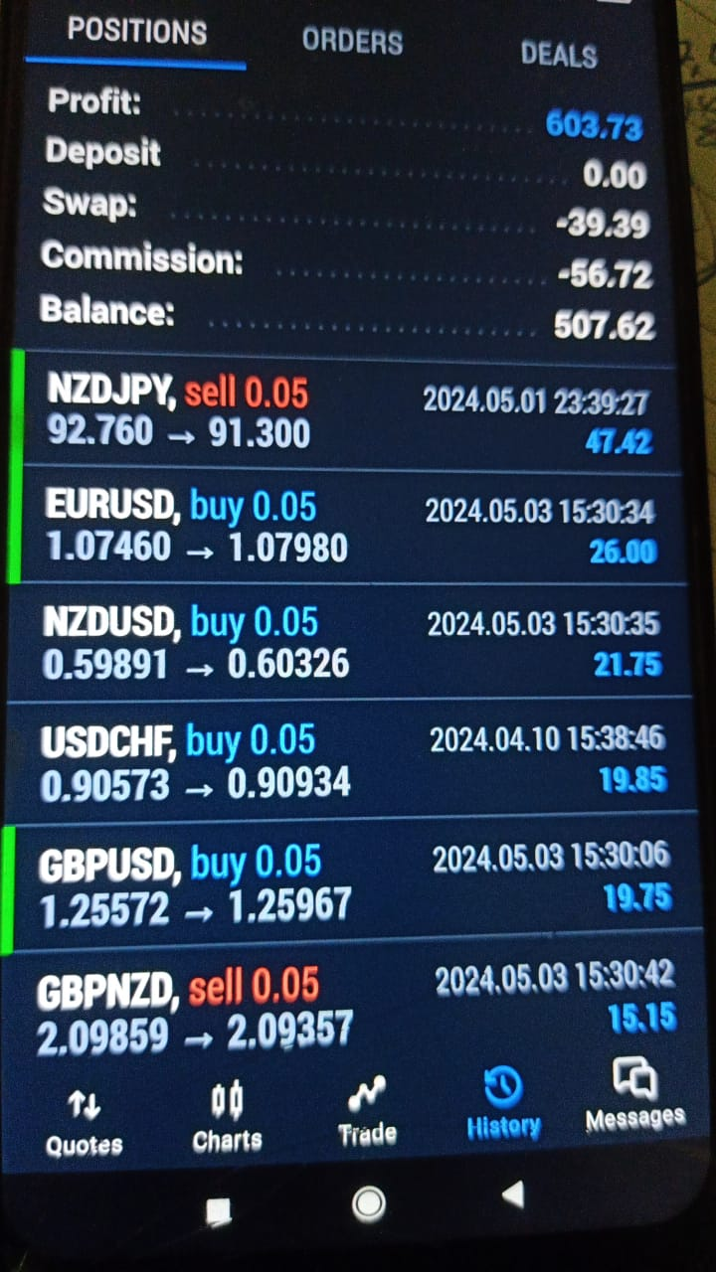
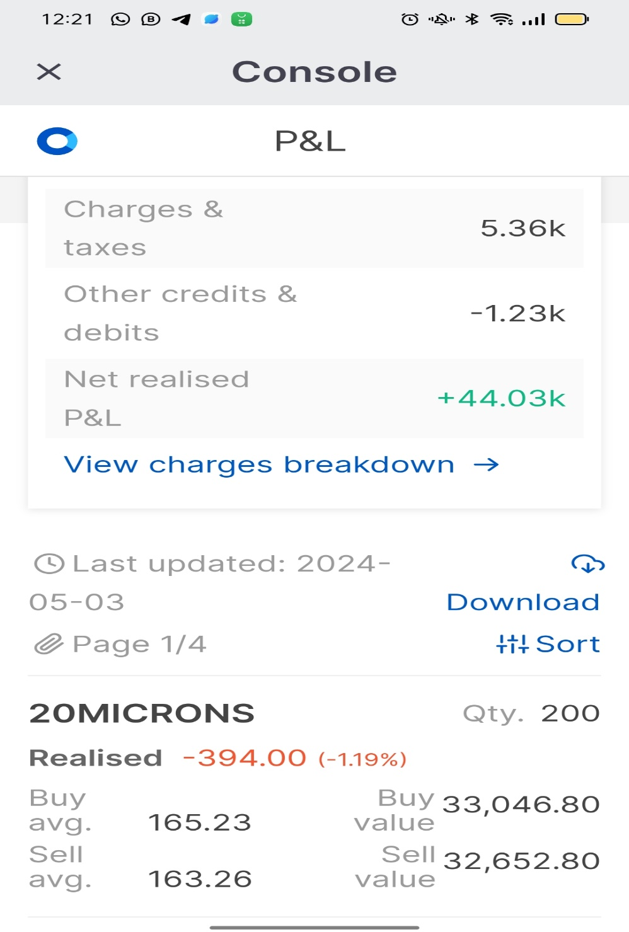
Profit proofs

Slide 38

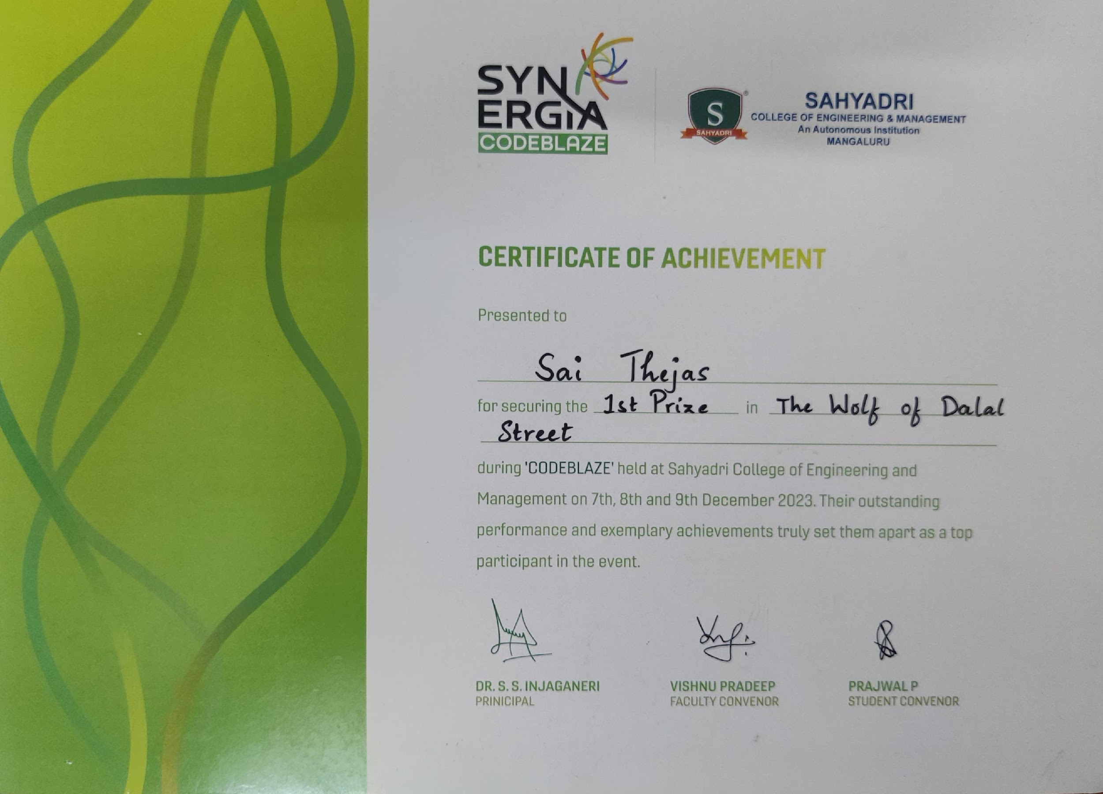
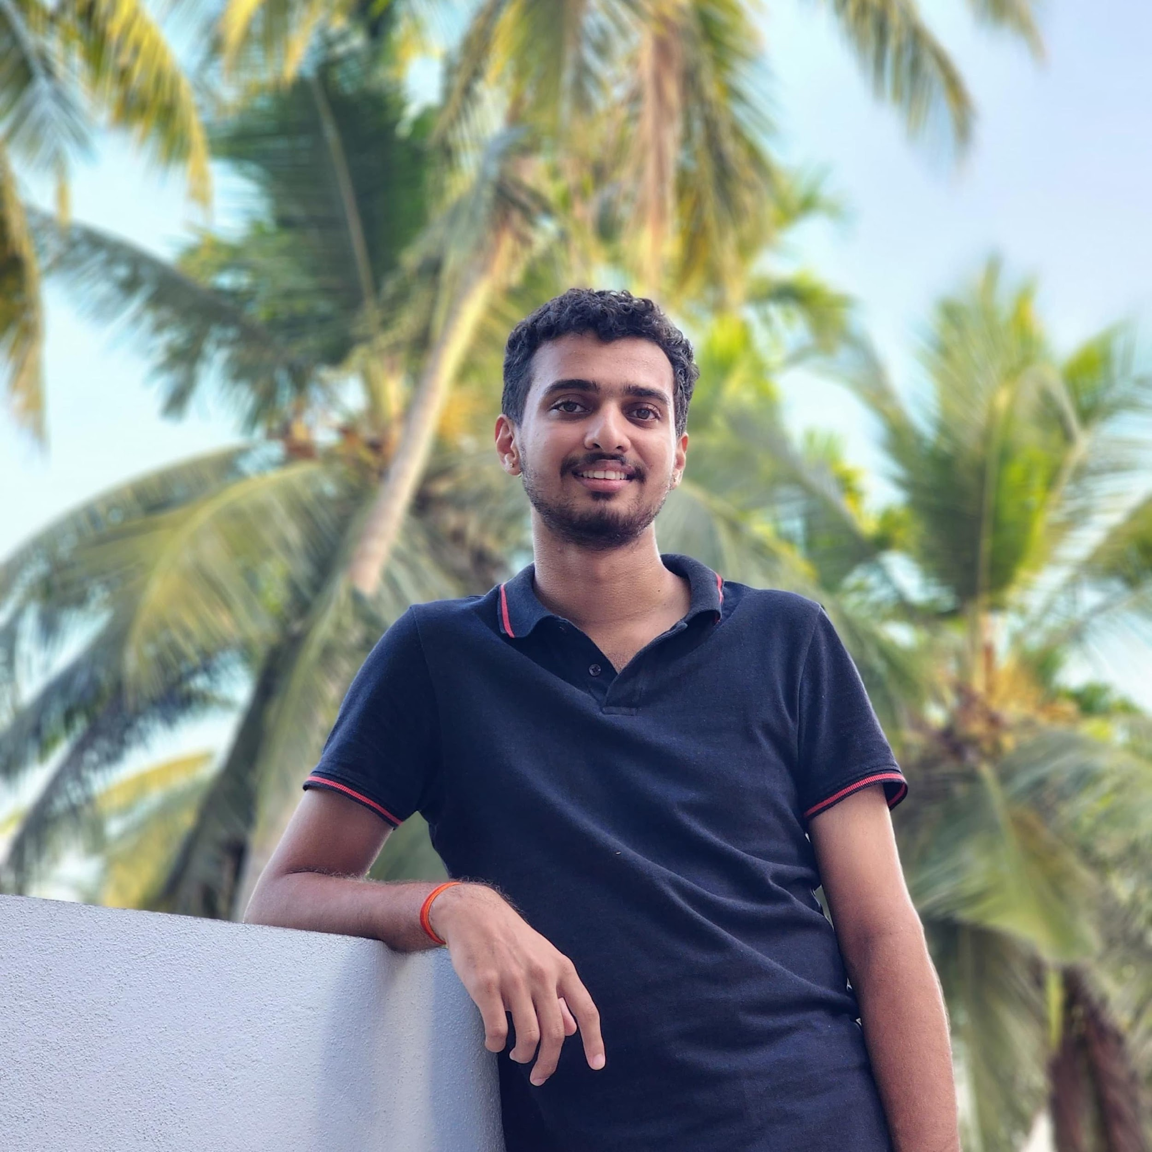
Student Achievement
Our Student named Sai Thejas who is pursuing engineering degree has participated in the Trading Competition organized by Sahyadri College and won First Prize using our strategy and Analysis setup. He has got this certificate and Rupees 5000 as Token of Appreciation.

Slide 39
5 C’s for Trading Success
Clarity on Goals
Confidence
Competence
Coaching
Community

Slide 40
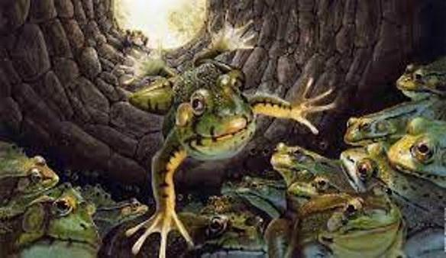
Story of a Frog

Slide 41
WEALTH IS THE ABILITY TO FULLY EXPERIENCE LIFE.
-Henry David Thoreau

Slide 42
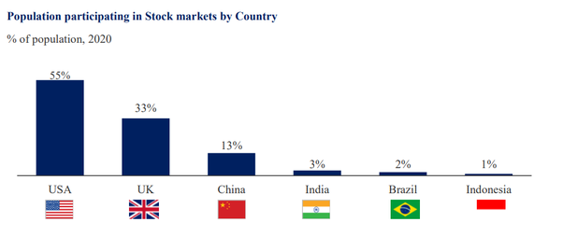
Preference towards physical assets like land, gold etc
Unwillingness
Lack of capital
No proper courses
Lack of knowledge/guidance
Not willing to take the risk
Common Investing myths in India
Lack of awareness
No security in exchanges
Why People lose money in stocks
1. Investing Based on ‘FREE TIPS’ & Not Doing Proper Research
2. Trying to Make Money Quickly
3. Sudden Overexposure to Market
4. Holding onto Losses while Booking Profits Early
5. Lack of patience
6. Blindly Following the Crowd.

Slide 43
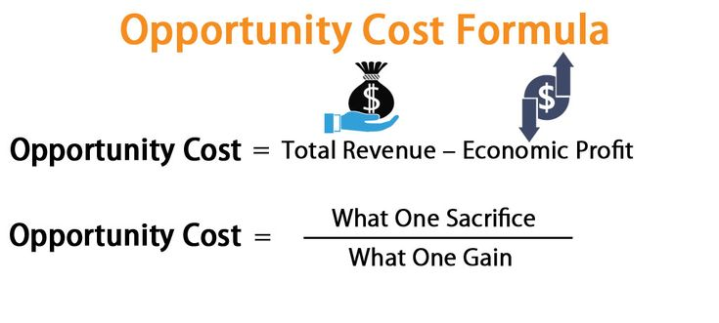
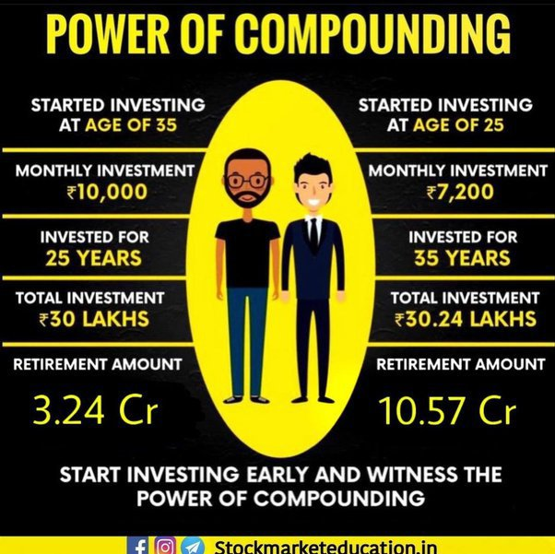

Slide 44
Coaching Offer | Value
5 Days personal mentoring in live market | ₹ 20,000
3 Days in person coaching on graphs and tools | ₹ 15,000
2 days in person coaching on identifying triggers | ₹ 10,000
Momentum trading e-book | ₹ 4,000
Pro trader blue print e-book | ₹6,000
Trade planner template | ₹5,000
Candle stick patterns | ₹4,000
Breakout patterns cheat sheet used by top traders | ₹10,000
Total | ₹74,000

Slide 45
Coaching Offered | Value
2 hours of in-person online coaching on risk management | ₹5,000
Session on controlling emotions and mind management | ₹5,000
Proven scalping techniques online session | ₹5,000
Access to community and inner circle master mind weekly | ₹12,000
Weekly/Daily Stock selection filter | ₹15,000
Crypto fundamentals and growth cryptos -2 hours webinar | ₹5,000
TOTAL | ₹47,000
Grand total ₹74,000+₹47,000 | ₹1,21,000

Slide 46
Recap…
What all we have learnt so far?
Lessons learnt from life
What is important - Importance of time?
Power of compounding
Why stock market is a good source of wealth?
Why you have to take action- Traditional education Vs a skill

Slide 47
Total Value of this course
₹1,21,000+GST
After 50% discount
₹60,500+GST

Slide 48
Recap…
My vision and why i am offering this course
What values you are getting from this course?
Coach vs Training differences
Why you have to participate in my training?

Slide 49

100% Money back Guarantee if you don’t make money in 100 Days
But Our offer for you today
₹8,999+ GST
OFFER IS VALID FOR 20 MINS ONLY
Only 40 Slots available - First come basis
*Terms and Conditions apply

Slide 50
Keshav moorthy Chandrashekar
Thank you!

